Slide 1
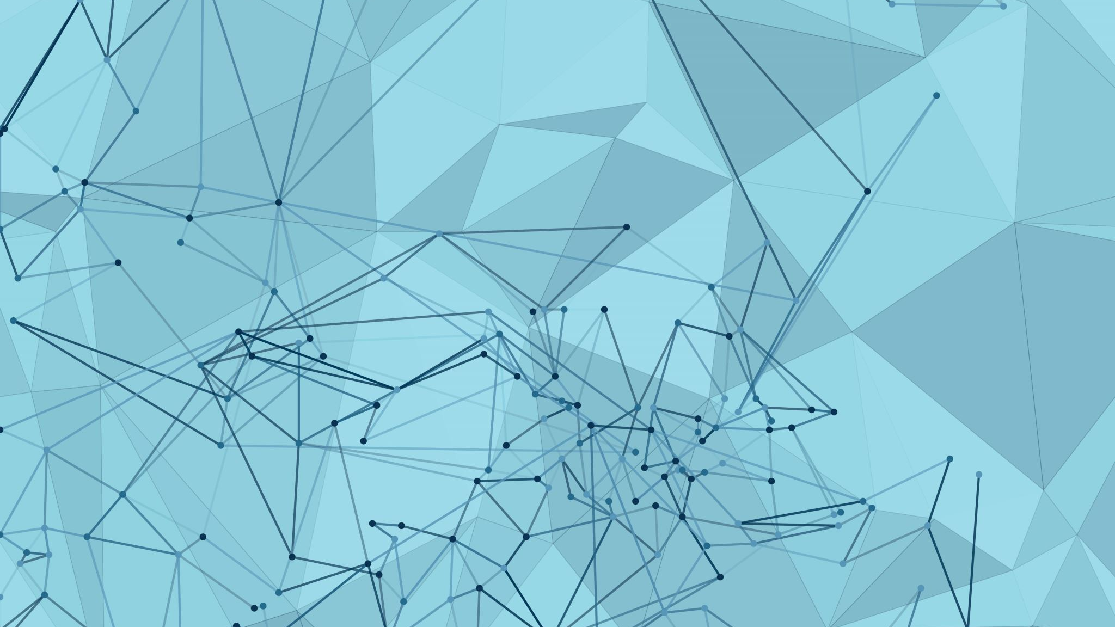
Summer school on Quantum Cryptography (IMPLEMENTATIONS)
GENERATION QI
Next generation of quantum information scientists. Series of international schools
for students in Gdańsk.
University of Gdańsk

Slide 2
Why the quantum cryptography?
Quantum hardware will be able to crack RSA and other security assuring algorithms in a forseeable future
Quantum cryptography offers security against quantum attacks
Security of Quantum cryptography is unconditional in opposition to computational assumption based ones
Quantum key distributions reaches commertial use nowadays
Quantum security can be potentially extended in distance in a future Quantum Internet

Slide 3
who ?
Mikołaj Czechlewski (Institute of Informatics, University of Gdańsk)
(Attacks on quantum internet)
Karol Horodecki (Institute of Informatics, ICTQT, University of Gdańsk)
(Attacks on quantum key distribution devices)
Krystian Matusiewicz (Intel Corporation, Gdańsk)
(Post-quantum cryptography)
Gláucia Murta (Heinrich-Heine-Universität Düsseldorf)
(Anonymous quantum key distribution)
Marcin Pawłowski (University of Gdańsk)
(Practical QKD protocols; attacks on QKD devices)
Maciej Stankiewicz (Institute of Informatics, University Of Gdańsk)
(private randomness as quantum cryptographic resource)
Bianka Wołoncewicz (ICTQT, University of Gdańsk)
(Upper bounds on QKD key rates)
Guilherme Xavier (Linköping University)
(Practical QKD protocols)

Slide 4
For whom ?
The school is dedicated to students who whish to learn basics of theory and practice of quantum cryptography
We welcome those who are interested in academic/industrial careeer related to development of quantum-based security and quantum Internet
The school introduces all the physics and mathematics needed to understand the concepts of quantum key distribution. Basic knowledge about algebra and probability theory is welcome.
All the young applicants can contiue the studies in our master program Quantum Information Technologies at the University of Gdańsk

Slide 5
Implementations of quantum cryptography
Introduction to Quantum Optics (one day)
Mathematical description of key optical components and their physical properties
Practical realizations of quantum key distribution protocols (one day)
The practical issues arising in realization of QKD protocols for existing implementations and future possibilities
Atacks on QKD and quantum networks(one day)
Attacks on QKD protocols including: photon numer splitting, detector blinding and possible countermeasures
Quantum secrecy beyond QKD: post-quantum cryptography(one day)
Classical quantum-safe cryptography including lattice and hash based protocols
Private Randomness (one day)
Randomness extraction and amplification protocols and methods for proving their privacy

Slide 6
Based on literature
M.A. Nielsen, I.L. & Chuang, 2011. „Quantum Computation and Quantum Information: 10th Anniversary” Edition, Cambridge University Press.
S. Sun & A. Huang „ A Review of Security Evaluation of Practical Quantum Key Distribution System” Entropy 2022, 24(2), 260
T. Satoh et al. “Attacking the Quantum Internet ” IEEE Transactions on Quantum Engineering 2 (2021): 1-17
Grasselli, et al. „Secure anonymous conferencing in quantum networks”. PRX Quantum 3, 040306
Bera et al. „Randomness in Quantum Mechanics: Philosophy, Physics and Technology Rep. Prog. Phys. 80, 124001 (2017)

